Slide 1
Generative AI and Transformers

Slide 2
Recurrent Models
Recurrent models like LSTMs and GRUs have been widely used for sequence tasks such as language modeling, but they come with several inherent limitations.
The primary problem with recurrent models is their sequential nature, where each step depends on the previous one, leading to slow training and difficulties in capturing long-range dependencies.
As the sequence length increases, recurrent models struggle with vanishing gradients, making it hard for them to retain information over long distances in a sequence.
Additionally, recurrent models process data sequentially, limiting parallelization, which results in inefficiency for large datasets.
The parallelization problem in recurrent models arises because they process input sequences sequentially, meaning each step depends on the output of the previous step. This prevents the model from processing multiple elements of the sequence at the same time, limiting the ability to leverage parallel computing resources and leading to slower training, especially for long sequences.

Slide 3
Transformers
Transformers, introduced in the paper "Attention is All You Need," address these issues by using self-attention mechanisms that allow the model to attend to all parts of a sequence simultaneously, without the need for sequential processing.
This parallelization significantly speeds up training.
The self-attention mechanism enables transformers to capture long-range dependencies more effectively, as each token can directly attend to any other token in the sequence, no matter how far apart they are.
This architecture also handles long sequences better without suffering from the vanishing gradient problem.
As a result, transformers outperform recurrent models in tasks involving long sequences, such as machine translation, text generation, and many other NLP applications.

Slide 4
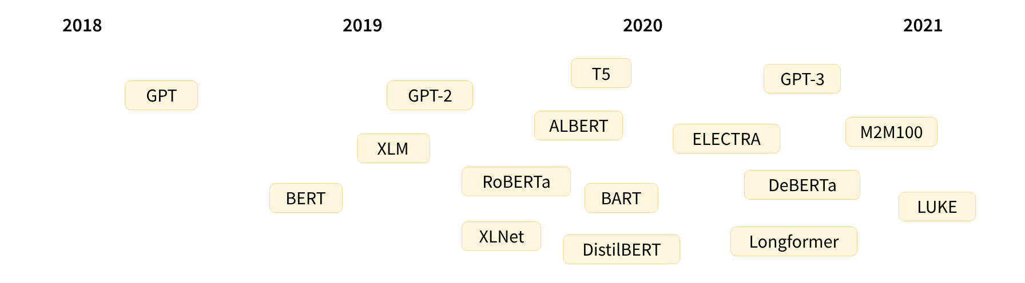
A bit of Transformer history

Slide 5
A bit of Transformer history
The Transformer architecture was introduced in June 2017. The focus of the original research was on translation tasks. This was followed by the introduction of several influential models, including:
June 2018: GPT, the first pretrained Transformer model, used for fine-tuning on various NLP tasks and obtained state-of-the-art results
October 2018: BERT, another large pretrained model, this one designed to produce better summaries of sentences (more on this in the next chapter!)
February 2019: GPT-2, an improved (and bigger) version of GPT that was not immediately publicly released due to ethical concerns
October 2019: DistilBERT, a distilled version of BERT that is 60% faster, 40% lighter in memory, and still retains 97% of BERT’s performance
October 2019: BART and T5, two large pretrained models using the same architecture as the original Transformer model (the first to do so)
May 2020, GPT-3, an even bigger version of GPT-2 that is able to perform well on a variety of tasks without the need for fine-tuning (called zero-shot learning)

Slide 6
A bit of Transformer history
Broadly, they can be grouped into three categories:
GPT-like (also called auto-regressive Transformer models)
BERT-like (also called auto-encoding Transformer models)
BART/T5-like (also called sequence-to-sequence Transformer models)

Slide 7
Transformers are language models
All the Transformer models mentioned above (GPT, BERT, BART, T5, etc.) have been trained as language models. This means they have been trained on large amounts of raw text in a self-supervised fashion. Self-supervised learning is a type of training in which the objective is automatically computed from the inputs of the model. That means that humans are not needed to label the data!
This type of model develops a statistical understanding of the language it has been trained on, but it’s not very useful for specific practical tasks. Because of this, the general pretrained model then goes through a process called transfer learning. During this process, the model is fine-tuned in a supervised way — that is, using human-annotated labels — on a given task.
An example of a task is predicting the next word in a sentence having read the n previous words. This is called causal language modeling because the output depends on the past and present inputs, but not the future ones.

Slide 8
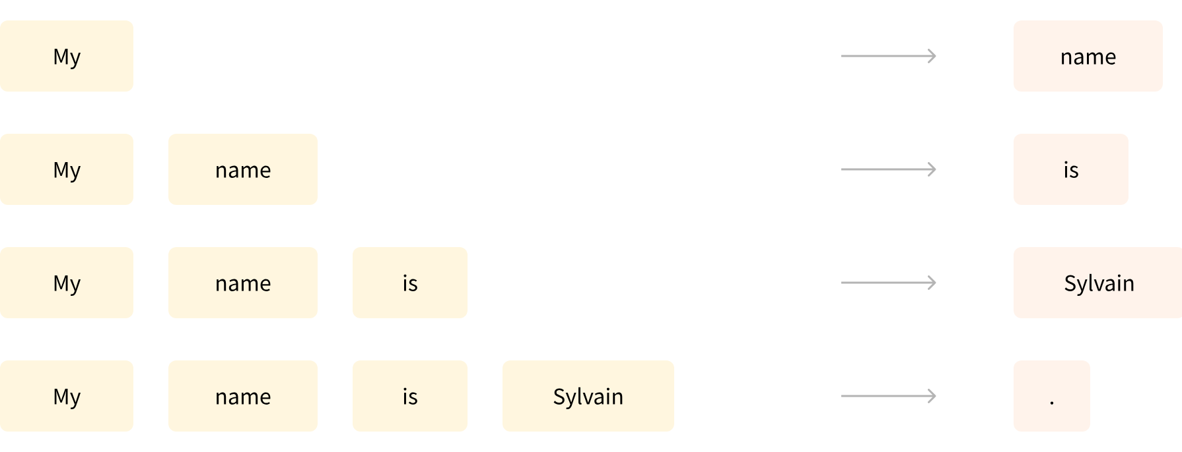
Next word Prediction

Slide 9
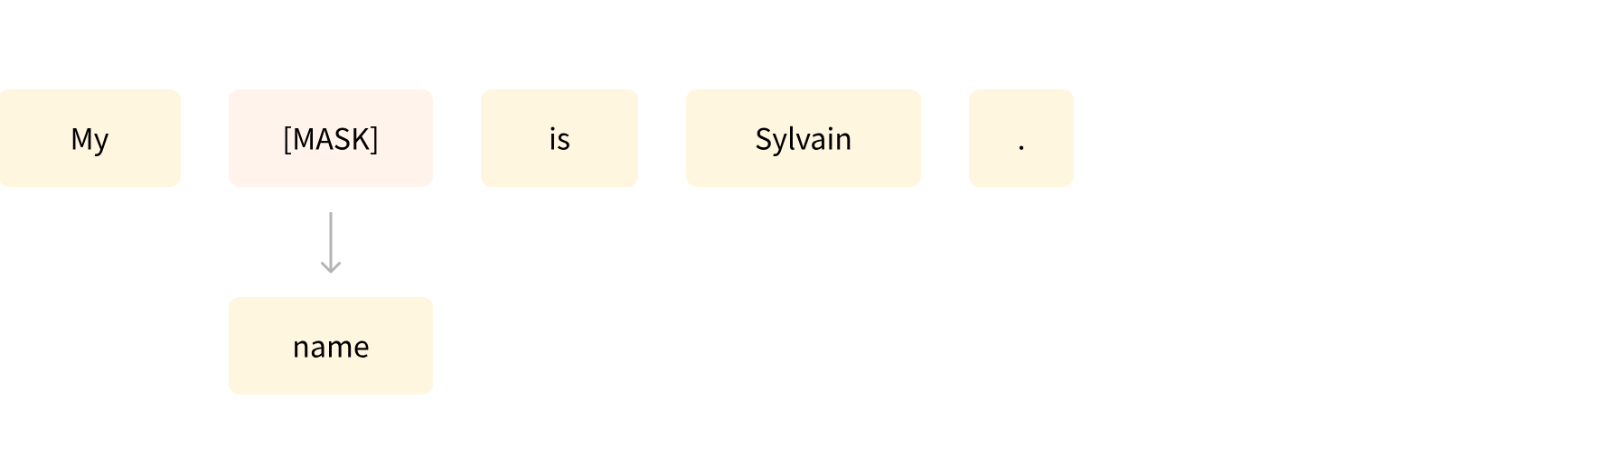
MLM

Slide 10
Transformers are big models
Apart from a few outliers (like DistilBERT), the general strategy to achieve better performance is by increasing the models’ sizes as well as the amount of data they are pretrained on.

Slide 11
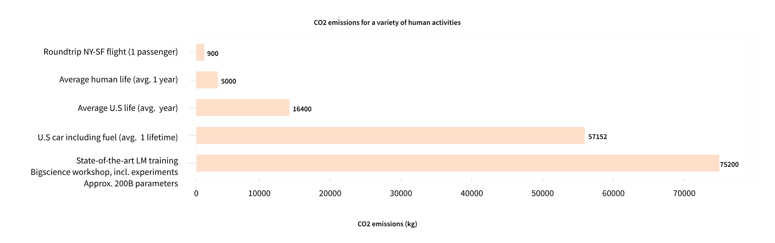
CO2 Emissions

Slide 12
Global Implications
Imagine if each time a research team, a student organization, or a company wanted to train a model, it did so from scratch. This would lead to huge, unnecessary global costs!
This is why sharing language models is paramount: sharing the trained weights and building on top of already trained weights reduces the overall compute cost and carbon footprint of the community.

Slide 13
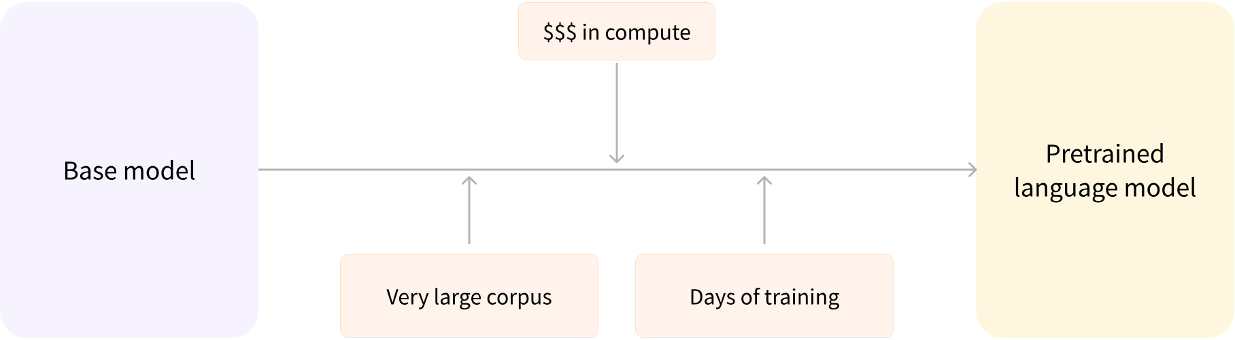
Pretraining

Slide 14
Finetuning – Transfer Learning
This pretraining is usually done on very large amounts of data. Therefore, it requires a very large corpus of data, and training can take up to several weeks.
Fine-tuning, on the other hand, is the training done after a model has been pretrained. To perform fine-tuning, you first acquire a pretrained language model, then perform additional training with a dataset specific to your task. Wait — why not simply train the model for your final use case from the start (scratch)? There are a couple of reasons:
The pretrained model was already trained on a dataset that has some similarities with the fine-tuning dataset. The fine-tuning process is thus able to take advantage of knowledge acquired by the initial model during pretraining (for instance, with NLP problems, the pretrained model will have some kind of statistical understanding of the language you are using for your task).
Since the pretrained model was already trained on lots of data, the fine-tuning requires way less data to get decent results.
For the same reason, the amount of time and resources needed to get good results are much lower.
For example, one could leverage a pretrained model trained on the English language and then fine-tune it on an arXiv corpus, resulting in a science/research-based model. The fine-tuning will only require a limited amount of data: the knowledge the pretrained model has acquired is “transferred,” hence the term transfer learning.

Slide 15
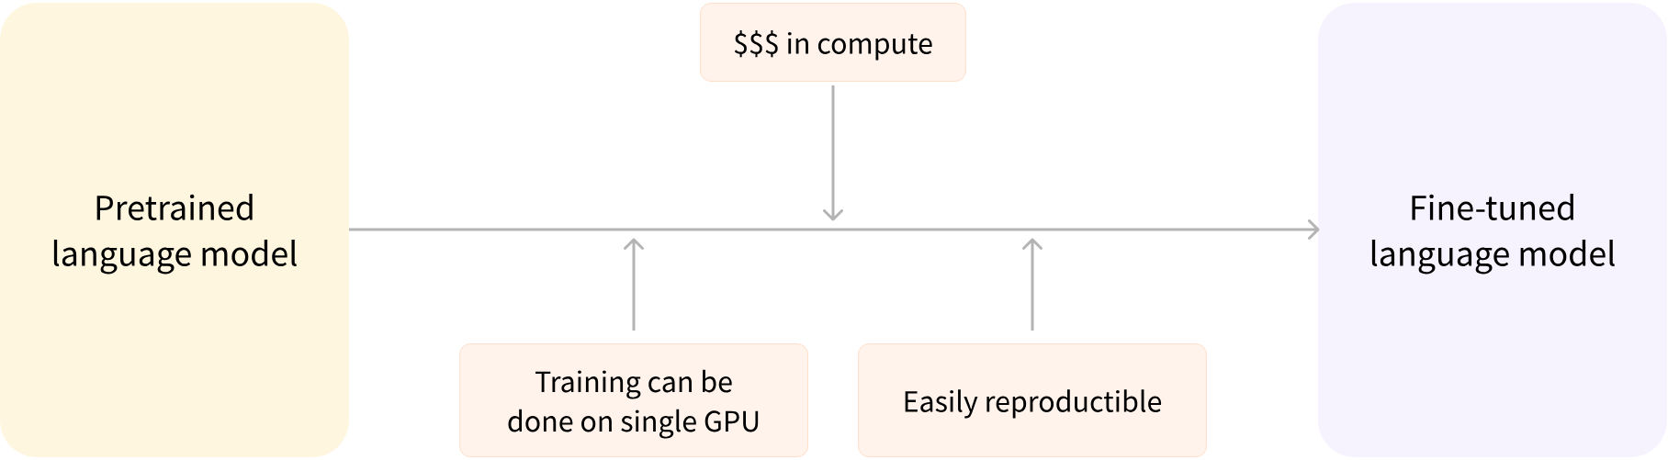
Finetuning – Transfer Learning

Slide 16
Finetuning – Transfer Learning
Fine-tuning a model therefore has lower time, data, financial, and environmental costs. It is also quicker and easier to iterate over different fine-tuning schemes, as the training is less constraining than a full pretraining.
This process will also achieve better results than training from scratch (unless you have lots of data), which is why you should always try to leverage a pretrained model — one as close as possible to the task you have at hand — and fine-tune it.

Slide 17
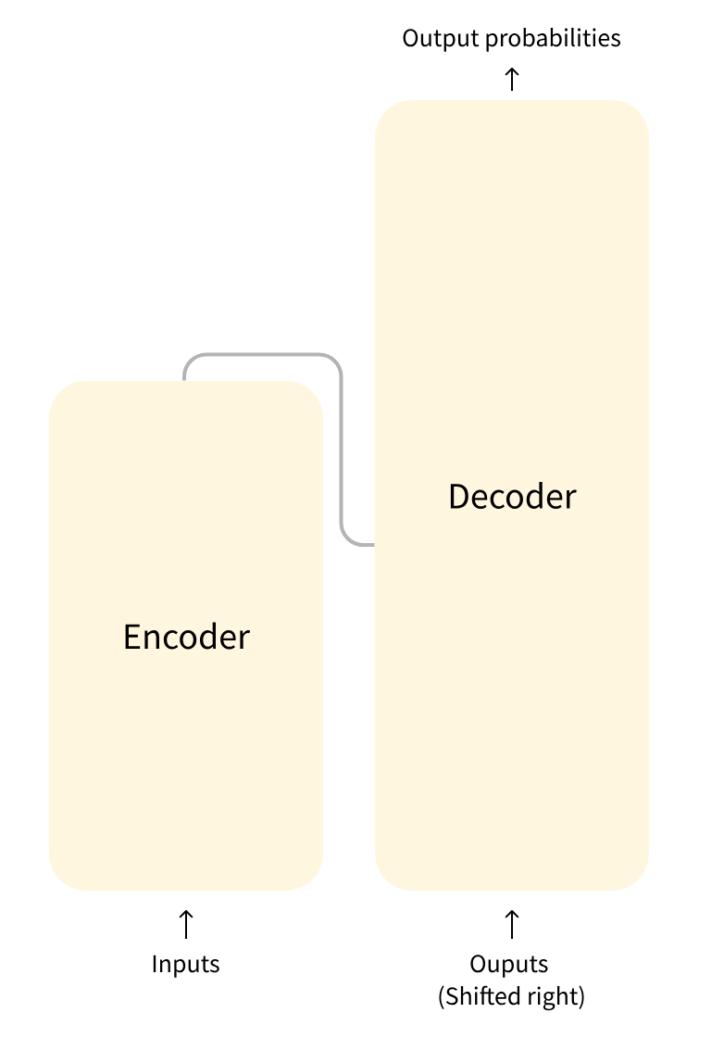
Transformers
The model is primarily composed of two blocks:
Encoder (left): The encoder receives an input and builds a representation of it (its features). This means that the model is optimized to acquire understanding from the input.
Decoder (right): The decoder uses the encoder’s representation (features) along with other inputs to generate a target sequence. This means that the model is optimized for generating outputs.

Slide 18
Transformers
Each of these parts can be used independently, depending on the task:
Encoder-only models: Good for tasks that require understanding of the input, such as sentence classification and named entity recognition.
Decoder-only models: Good for generative tasks such as text generation.
Encoder-decoder models or sequence-to-sequence models: Good for generative tasks that require an input, such as translation or summarization.

Slide 19
Attention layers
A key feature of Transformer models is that they are built with special layers called attention layers. In fact, the title of the paper introducing the Transformer architecture was “Attention Is All You Need”!.
The Transformer architecture was originally designed for translation. During training, the encoder receives inputs (sentences) in a certain language, while the decoder receives the same sentences in the desired target language. In the encoder, the attention layers can use all the words in a sentence (since, as we just saw, the translation of a given word can be dependent on what is after as well as before it in the sentence). The decoder, however, works sequentially and can only pay attention to the words in the sentence that it has already translated (so, only the words before the word currently being generated). For example, when we have predicted the first three words of the translated target, we give them to the decoder which then uses all the inputs of the encoder to try to predict the fourth word.
To speed things up during training (when the model has access to target sentences), the decoder is fed the whole target, but it is not allowed to use future words (if it had access to the word at position 2 when trying to predict the word at position 2, the problem would not be very hard!). For instance, when trying to predict the fourth word, the attention layer will only have access to the words in positions 1 to 3.

Slide 20
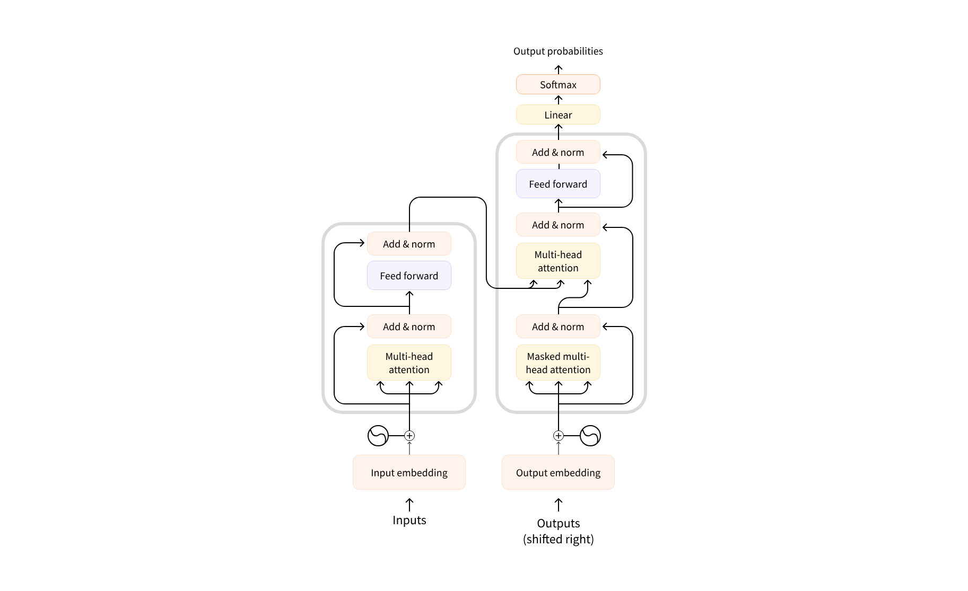
Transformers with Attention Layers
Note that the first attention layer in a decoder block pays attention to all (past) inputs to the decoder, but the second attention layer uses the output of the encoder.

Slide 21
Architectures vs. checkpoints
Architecture: This is the skeleton of the model — the definition of each layer and each operation that happens within the model.
Checkpoints: These are the weights that will be loaded in a given architecture.
Model: This is an umbrella term that isn’t as precise as “architecture” or “checkpoint”: it can mean both. This course will specify architecture or checkpoint when it matters to reduce ambiguity.
For example, BERT is an architecture while bert-base-cased, a set of weights trained by the Google team for the first release of BERT, is a checkpoint.

Slide 22
Encoder Only Models
Encoder models use only the encoder of a Transformer model. At each stage, the attention layers can access all the words in the initial sentence. These models are often characterized as having “bi-directional” attention, and are often called auto-encoding models.
The pretraining of these models usually revolves around somehow corrupting a given sentence (for instance, by masking random words in it) and tasking the model with finding or reconstructing the initial sentence.
Encoder models are best suited for tasks requiring an understanding of the full sentence, such as sentence classification, named entity recognition (and more generally word classification), and extractive question answering.
Representatives of this family of models include:
ALBERT
BERT
DistilBERT
ELECTRA
RoBERTa

Slide 23
Decoder only Models
Decoder models use only the decoder of a Transformer model. At each stage, for a given word the attention layers can only access the words positioned before it in the sentence. These models are often called auto-regressive models.
The pretraining of decoder models usually revolves around predicting the next word in the sentence.
These models are best suited for tasks involving text generation.
Representatives of this family of models include:
CTRL
GPT
GPT-2
Transformer XL

Slide 24
Encoder Decoder Models
Encoder-decoder models (also called sequence-to-sequence models) use both parts of the Transformer architecture.
At each stage, the attention layers of the encoder can access all the words in the initial sentence, whereas the attention layers of the decoder can only access the words positioned before a given word in the input.
The pretraining of these models can be done using the objectives of encoder or decoder models, but usually involves something a bit more complex. For instance, T5 is pretrained by replacing random spans of text (that can contain several words) with a single mask special word, and the objective is then to predict the text that this mask word replaces.
Sequence-to-sequence models are best suited for tasks revolving around generating new sentences depending on a given input, such as summarization, translation, or generative question answering.
Representatives of this family of models include:
BART
mBART
Marian
T5
https://youtu.be/0_4KEb08xrE?si=jn0iqmhhJOW-ixRu

Slide 25
Example Usage
from transformers import pipeline
unmasker = pipeline("fill-mask", model="bert-base-uncased")
result = unmasker("This man works as a [MASK].")
print([r["token_str"] for r in result])
result = unmasker("This woman works as a [MASK].")
print([r["token_str"] for r in result])

Slide 26
Transformers vs MAMBA

Slide 27
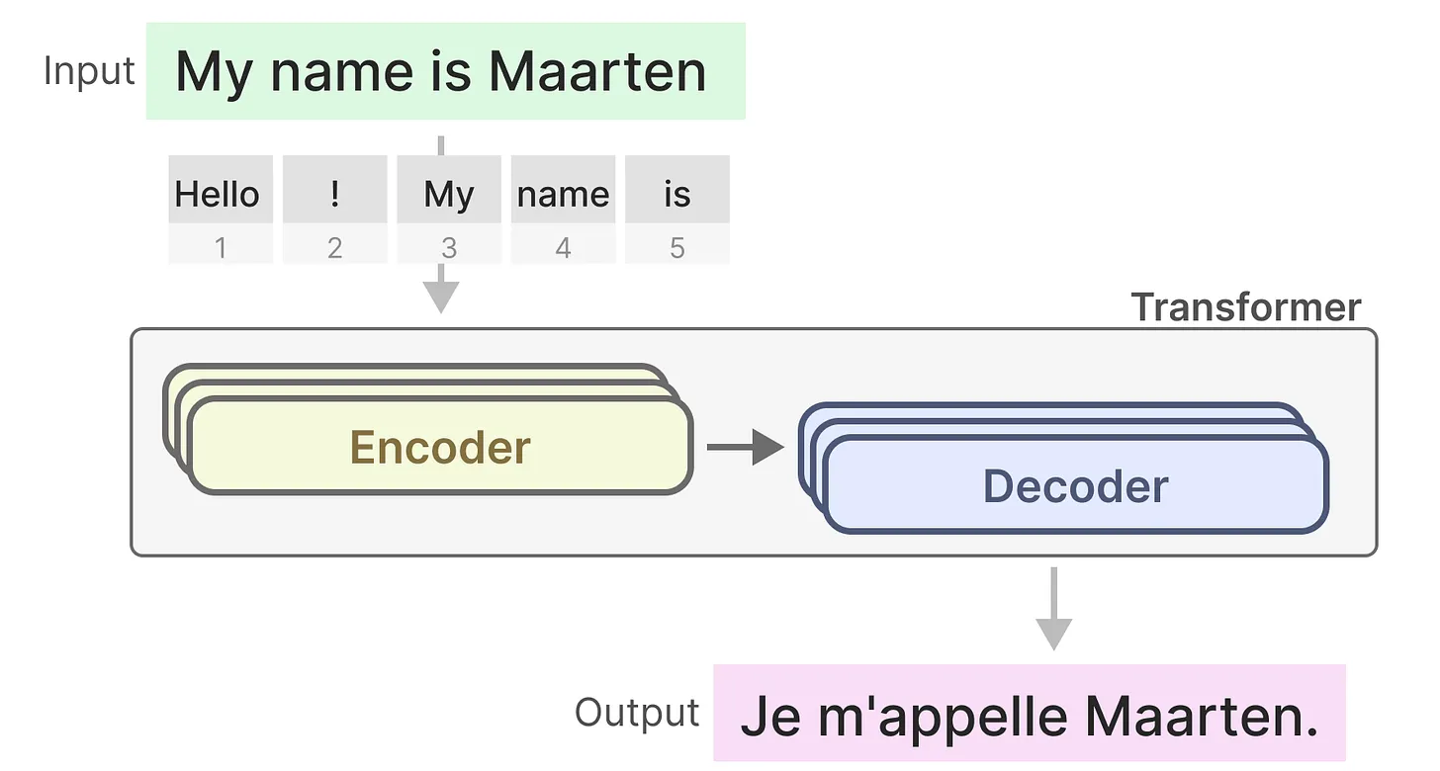
Transformers
Remember that a Transformer consists of two structures, a set of encoder blocks for representing text and a set of decoder blocks for generating text.
Together, these structures can be used for several tasks, including translation.

Slide 28
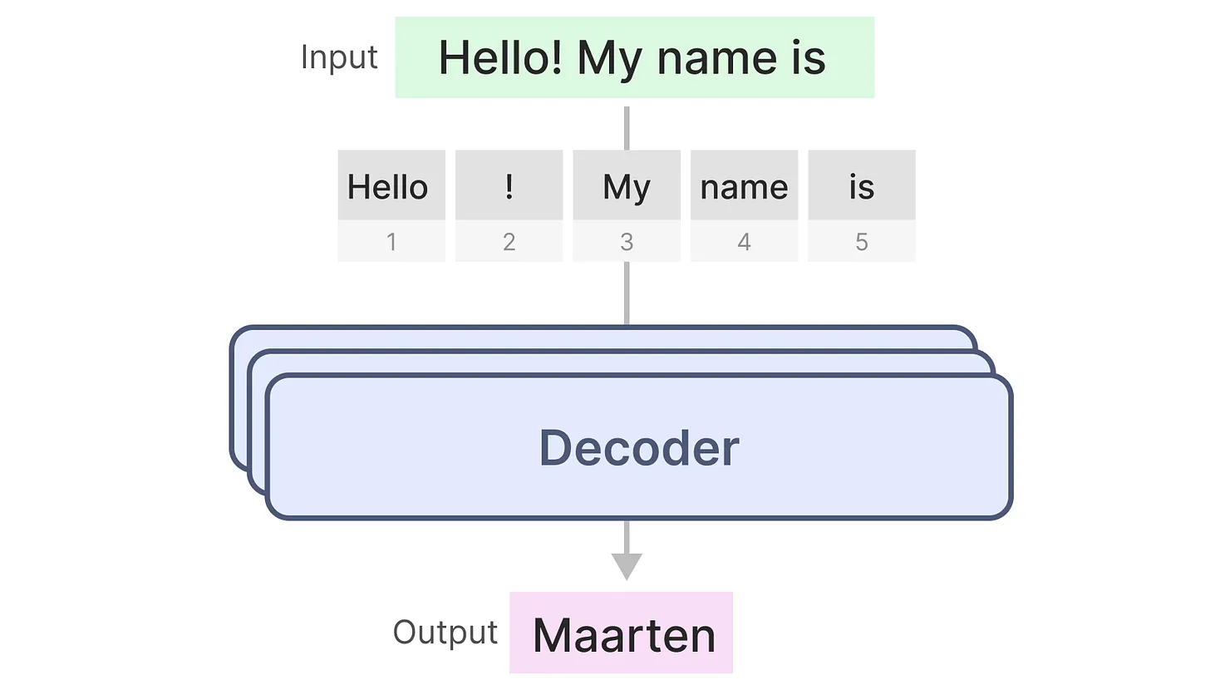
Transformers - Decoders
We can adopt this structure to create generative models by using only decoders. This Transformer-based model, Generative Pre-trained Transformers (GPT), uses decoder blocks to complete some input text.

Slide 29
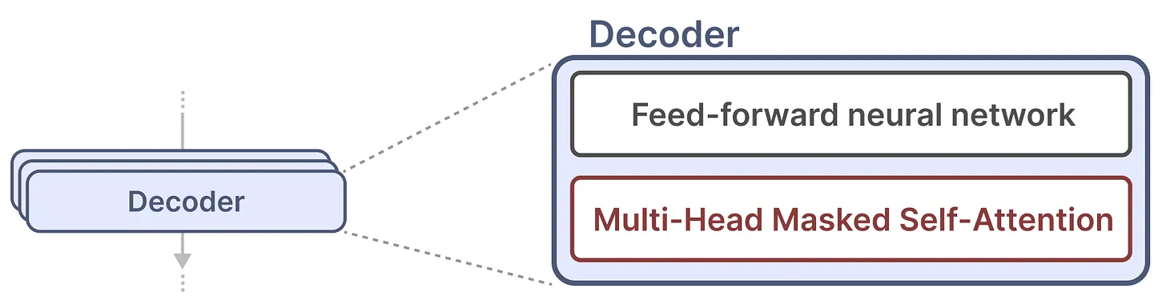
Transformers - Training
A single decoder block consists of two main components, masked self-attention followed by a feed-forward neural network.
Self-attention is a major reason why these models work so well. It enables an uncompressed view of the entire sequence with fast training.
So how does it work? It creates a matrix comparing each token with every token that came before. The weights in the matrix are determined by how relevant the token pairs are to one another.

Slide 30
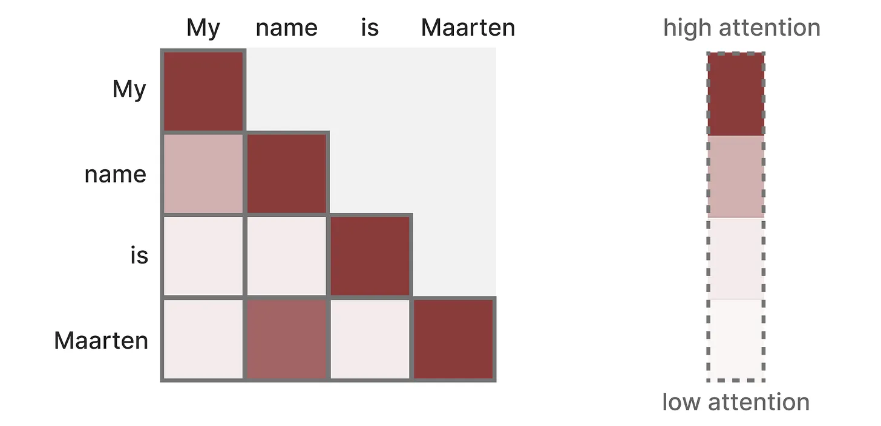
Transformers - Training
During training, this matrix is created in one go.
The attention between “My” and “name” does not need to be calculated first before we calculate the attention between “name” and “is”.
It enables parallelization, which speeds up training tremendously!

Slide 31
Transformers – Inference (Curse)
There is a flaw, however. When generating the next token, we need to re-calculate the attention for the entire sequence.
Generating tokens for a sequence of length L needs roughly L² computations which can be costly if the sequence length increases.
We see this limitation as the output tokens in case of LLMs.
This need to recalculate the entire sequence is a major bottleneck of the Transformer architecture.

Slide 32
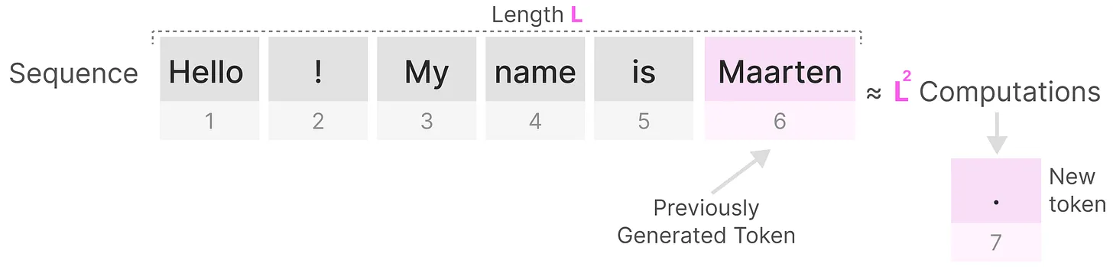
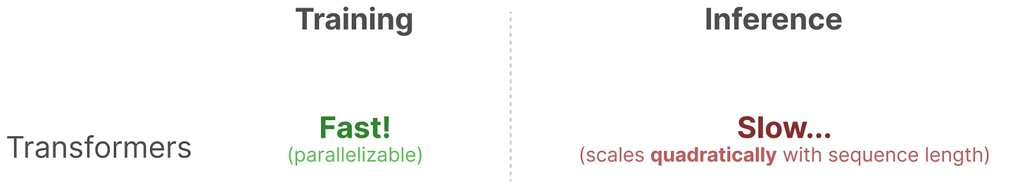
Transformers – Inference (Curse)

Slide 33
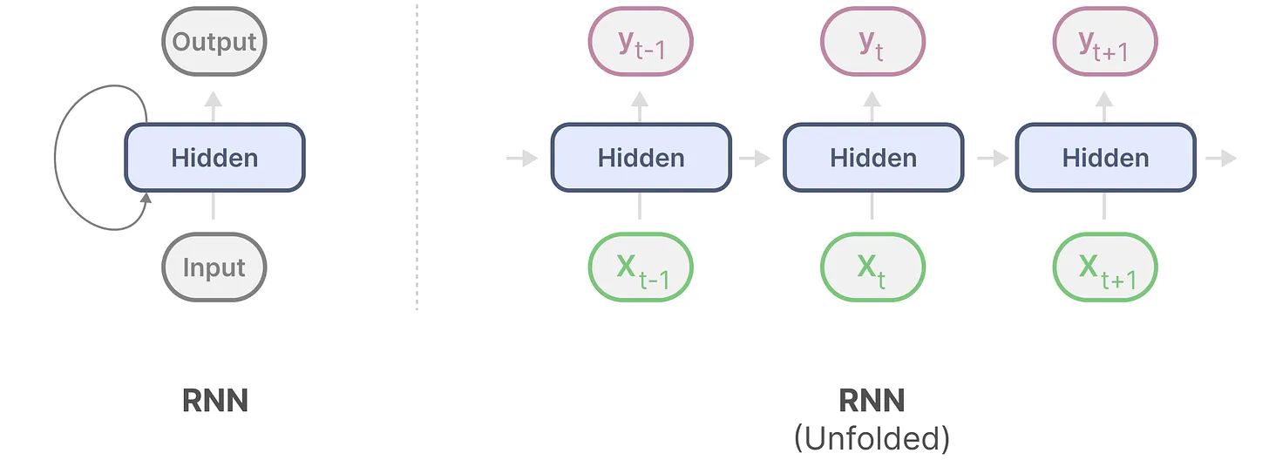
Are RNNs a Solution?
Recurrent Neural Networks (RNN) is a sequence-based network. It takes two inputs at each time step in a sequence, namely the input at time step t and a hidden state of the previous time step t-1, to generate the next hidden state and predict the output.
RNNs have a looping mechanism that allows them to pass information from a previous step to the next. We can “unfold” this visualization to make it more explicit.

Slide 34
RNNs
When generating the output, the RNN only needs to consider the previous hidden state and current input.
It prevents recalculating all previous hidden states which is what a Transformer would do.
In other words, RNNs can do inference fast as it scales linearly with the sequence length!
In theory, it can even have an infinite context length.

Slide 35
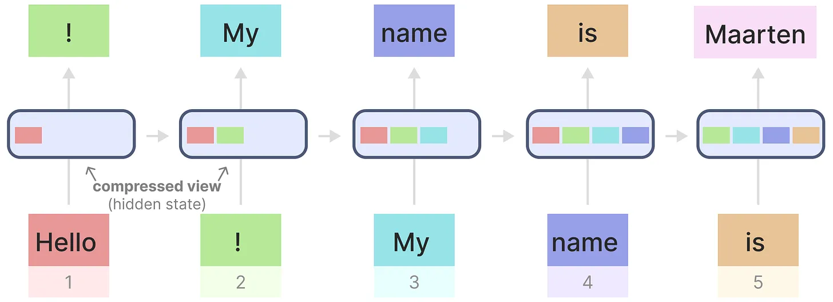
RNNs

